Slide 1
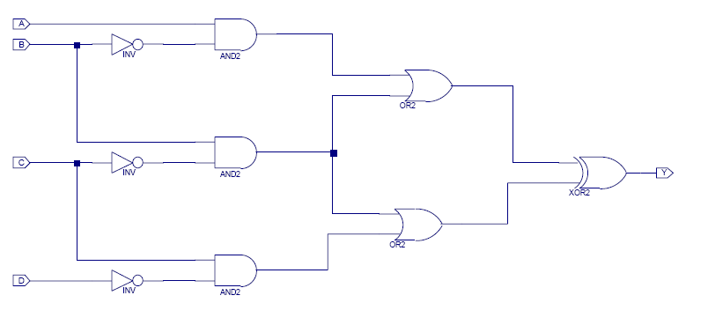
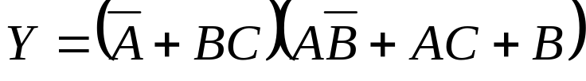


Examining Digital Logic Gates Drawn in Various Situations
Sam Gordon, Raquel Robinson, Warren Liang,
Christine Alvarado, Sarah Harris, and Tom Stahovich
Background. The Sketchers Research Group is in the process of creating a digital logic circuit recognition and modeling tool to be used as an interface for Xilinx and ModelSim. The team desired higher accuracy from their Symbol Recognizer, which determines the type of the logic gate, and wanted to look into training it on data specific to the user.
Approach. Determine if users draw their digital logic gates consistently across varying situations. Carry out a user study in which the users perform three different tasks: repeatedly drawing a single logic gate, copying a circuit schematic, and synthesizing a circuit from an equation. The users performed the tasks both on an HP Tablet PC and with a pen on paper taped over a Wacom Tablet connected to a computer.
AND, OR, XOR, NAND, NOR, NOT

Slide 2
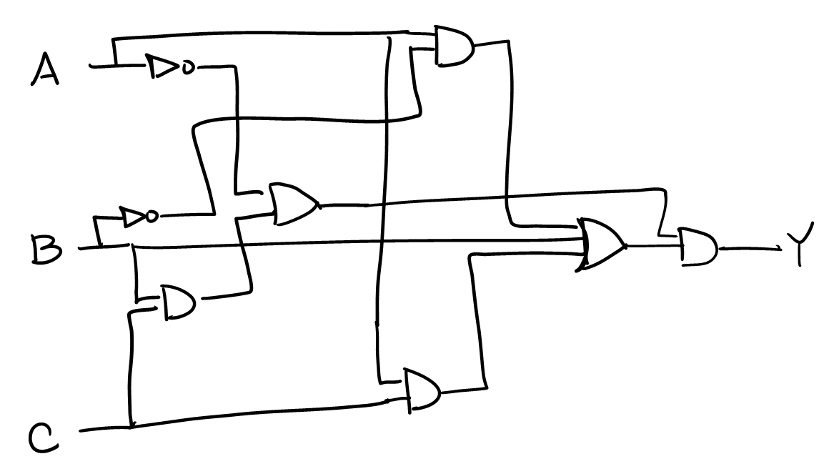
Analysis Technique. The data were first examined visually using bar graphs of characteristics such as average pressure, curvature, number of points, and size of a stroke for each type of gate. These bar graphs allowed for preliminary examination of trends in the data. Also, movies of the users drawing the sketches were created from timing information to watch the way the users drew the gates and wires.
The data were then tested for normality, and if they were found to be normal, a one-sample t-test was carried out at a 95% confidence level. If the data were found to be not normal, a sign non-parametric test for the median was performed.
P-Values from the tests were analyzed to determine if the average differences between characteristics from the data were the same.
Results. It was found that the time it took a user to draw a logic gate in the synthesis task was consistently longer than the time for the repeated task. The results from distance, number of strokes, and curvature were inconclusive.
Conclusions. If the team decided to train on timing, this information could prove to be extremely useful to them. As of now, they are not using time as any feature for its Symbol Recognizer.
Future Work. The rest of the data from the Tablet PC portion of the test still needs to be analyzed, the data from the pen and paper portion needs to be fully analyzed, the results from each half need to be compared with one another, and, finally, the Symbol Recognizer needs to be trained on sketches from either a single user or various users and then tested on other sketches.
Funding. Funded by the Baker Fellows and Beckman Research Funds.

